Slide 1
Population Health Modeling: Day 1

Slide 3
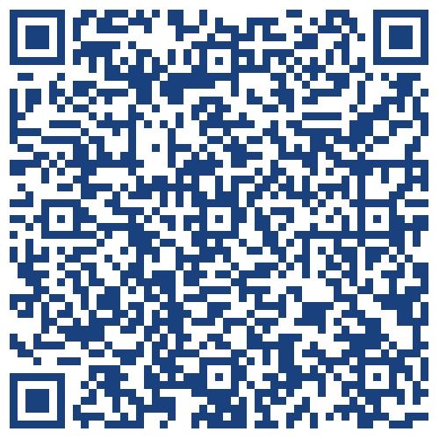
Starting off with some data collection

Slide 4
Salus populi suprema lex esto

Slide 5
Public Health is Big
Ideas and Disciplines
Societal Impact
Intersectionality
Public Health is Small
unobtrusive
small things- decisions, people, microbes, molecules
Why?

Slide 6
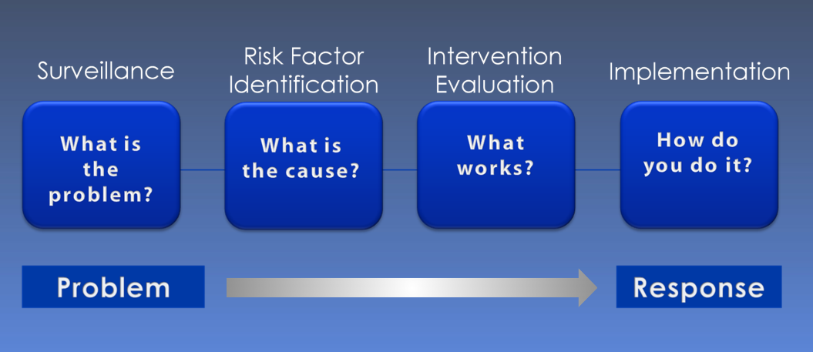
Purpose of Public Health Modeling
https://www.cdc.gov/training/publichealth101/e-learning/epidemiology/

Slide 7
How do we answer these questions?
Try being a data source!
Clinical Research
Develop interdisciplinary empathy
Be a good collaborator!
Laboratory Science
Understand datasets
Spot errors
Surveys
Design practice

Slide 8
Data sources
Individuals
Surveys, clinical records, autopsy reports ☹
Environment
Weather stations, water treatment facilities, etc.
Health Systems
EHRs
Other
Google location data, tobacco sales data, etc.

Slide 9
We Need Data!
Data need to be timely, accurate, complete, available, and accessible.
Population health data are almost always none of these things.

Slide 10
We don’t know what we don’t know, and when we do know what we don’t know, we don’t know what to do, you know?
Cascades of problems opportunities!
People who know what to do
People who can do it
People who know what we should do about it

Slide 11
Responsible Conduct of Research
Belmont Report
Tuskegee Airmen Study
Koko
Justice, Beneficence, Respect for Persons

Slide 12
Basic Principles of Public Health Modeling

Slide 13
All Models are Bad, Some Models are Useful
Irreducibly complex real-world problems
Understand your data source
State assumptions clearly
Measure twice, cut once

Slide 14
Course Overview
Infectious disease surveillance
Time series analysis
Hierarchical modeling
Genomic epidemiology
Market Basket Analysis
Compartmental modeling

Slide 15
Questions?

Slide 16
Time for a field trip!

